Slide 1
Imitation Learning

Slide 2
Introduction
Imitation Learning
Also known as learning by demonstration, apprenticeship learning
An expert demonstrates how to solve the task
Machine can also interact with the environment, but cannot explicitly obtain reward.
It is hard to define reward in some tasks.
Hand-crafted rewards can lead to uncontrolled behavior
Two approaches:
Behavior Cloning
Inverse Reinforcement Learning (inverse optimal control)
Notes:
əˋprɛntɪsʃɪp

Slide 3
Behavior Cloning

Slide 4
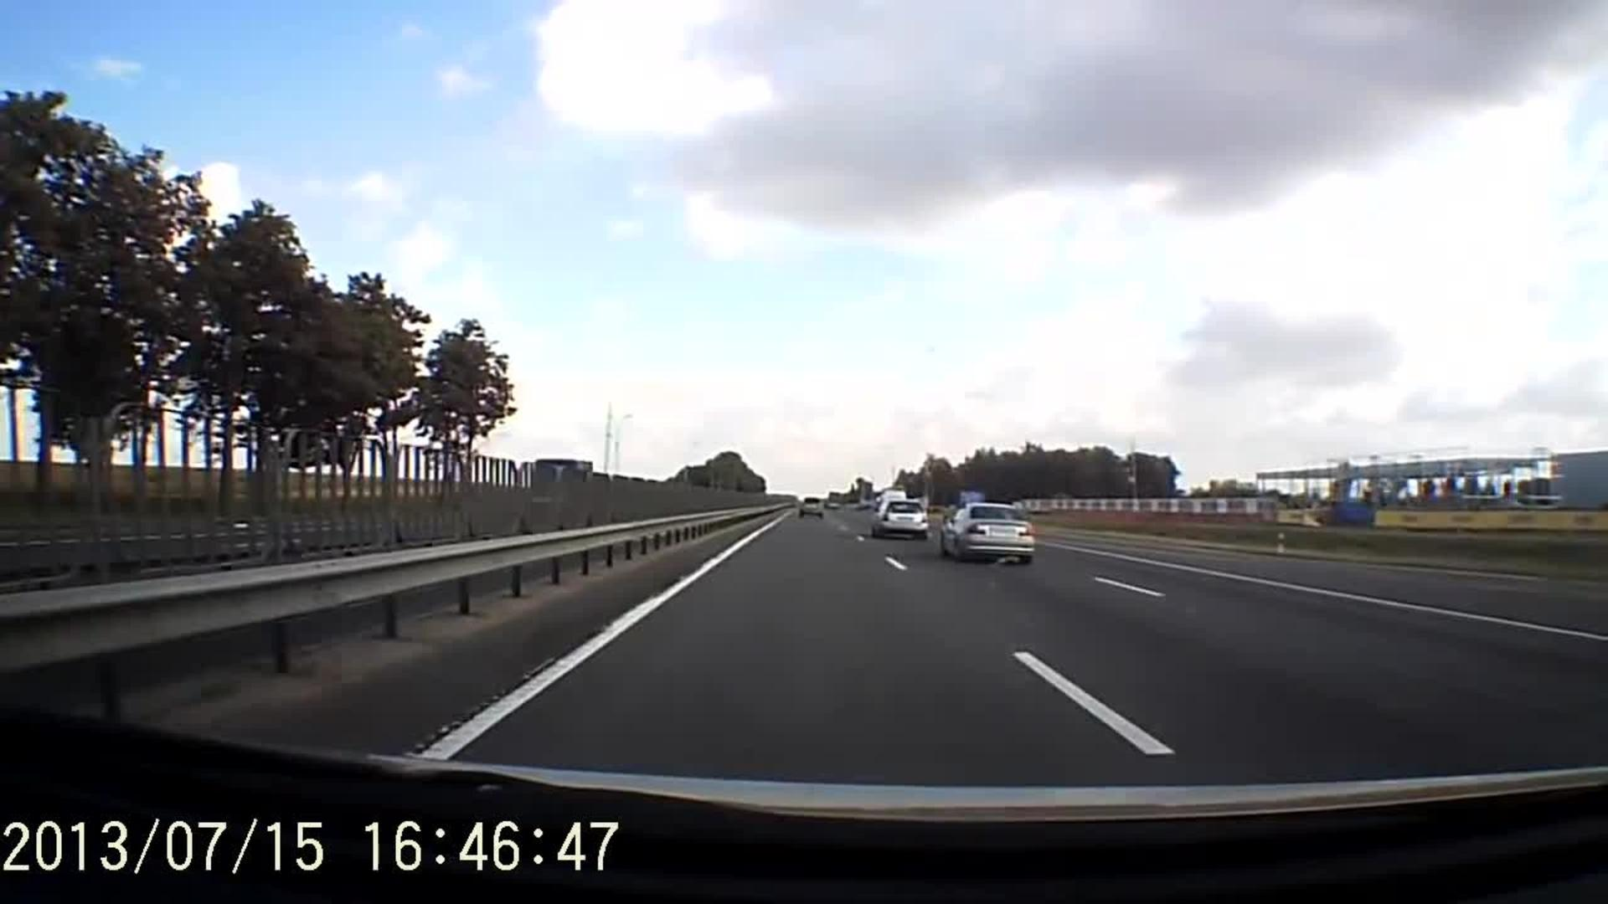
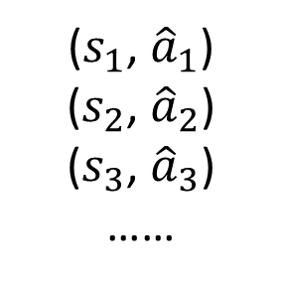
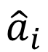
Behavior Cloning
Yes, this is supervised learning.
Self-driving cars as example
Expert (Human driver): 向前
observation
Machine: 向前
Training data:
($s_{1}$, ${\hat{a}}_{1}$)
($s_{2}$, ${\hat{a}}_{2}$)
($s_{3}$, ${\hat{a}}_{3}$)
……
NN
s_{i}
a_{i}
$${\hat{a}}_{i}$$
Actor

Slide 5
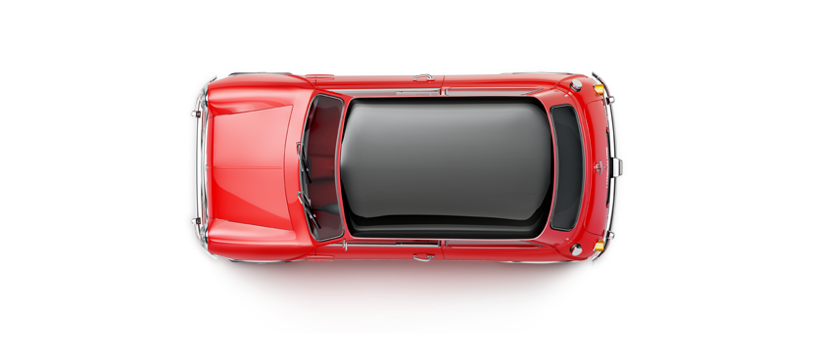
Behavior Cloning
Problem
Expert only samples limited observation (states)
?
Expert
Let the expert in the states seem by machine
Dataset Aggregation

Slide 6


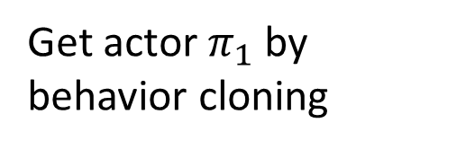
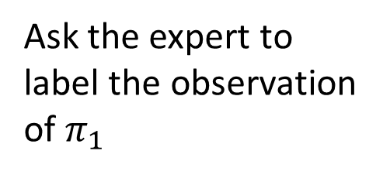
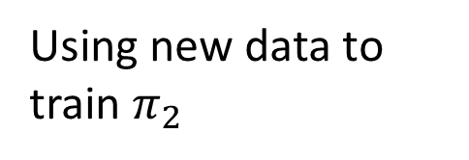
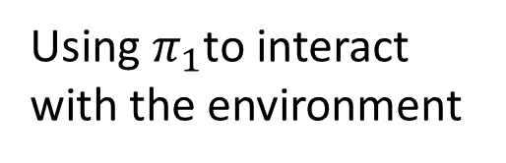
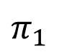
Behavior Cloning
Dataset Aggregation
Get actor $π_{1}$ by behavior cloning
Expert
Using $π_{1}$to interact with the environment
Expert
Ask the expert to label the observation of $π_{1}$
$π_{1}$
Using new data to train $π_{2}$

Slide 7

Behavior Cloning
The agent will copy every behavior, even irrelevant actions.
https://www.youtube.com/watch?v=j2FSB3bseek

Slide 8


Behavior Cloning
Major problem: if machine has limited capacity, it may choose the wrong behavior to copy.
Some behavior must copy, but some can be ignored.
Supervised learning takes all errors equally
speech
speech
NN
NN
s_{i}
a_{i}
s_{i}
a_{i}
gesture
gesture
Actor
Actor
Notes:
http://www.ipibresume.com/blog/blog/learn-the-core-of-how-to-succeed-in-career/
Steve Jobs 的例子
總結一句話：Correlation doesn't mean causation. 即使你輟學、經常辱罵員工、喜歡穿牛仔褲與套頭衫，你也成為不了Steve Jobs ：）
http://dariusforoux.com/stop-imitating-habits-successful-people/

Slide 9
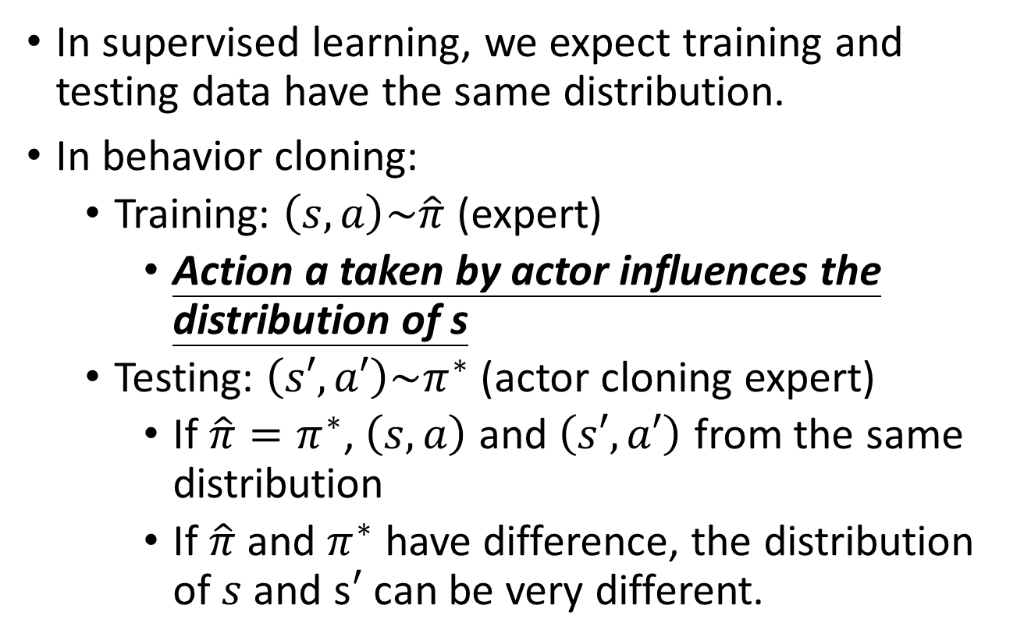
Mismatch
s_{i}
Actor
a_{i}
In supervised learning, we expect training and testing data have the same distribution.
In behavior cloning:
Training: $\left(s,a\right)\sim \hat{π}$ (expert)
Action a taken by actor influences the distribution of s
Testing: $\left(s′,a′\right)\sim π^{∗}$(actor cloning expert)
If $\hat{π}=π^{∗}$, $\left(s,a\right)$ and $\left(s′,a′\right)$ from the same distribution
If $\hat{π}$ and $π^{∗}$ have difference, the distribution of $s$ and s$′$ can be very different.

Slide 10
Inverse Reinforcement Learning (IRL)
Notes:
http://www.ipibresume.com/blog/blog/learn-the-core-of-how-to-succeed-in-career/
總結一句話：Correlation doesn't mean causation. 即使你輟學、經常辱罵員工、喜歡穿牛仔褲與套頭衫，你也成為不了Steve Jobs ：）
Apprentiship learning via inverse reinforcement learning will try to infer the goal of the teacher. In other words, it will learn a reward function from observation, which can then be used in reinforcement learning. If it discovers that the goal is to hit a nail with a hammer, it will ignore blinks and scratches from the teacher, as they are irrelevant to the goal.

Slide 11
Inverse Reinforcement Learning
demonstration of the expert
Environment
$$\left\{{\hat{τ}}_{1},{\hat{τ}}_{2},⋯,{\hat{τ}}_{N}\right\}$$
Reward Function
Inverse Reinforcement Learning
Optimal Actor
Reinforcement Learning
Expert
Using the reward function to find the optimal actor.
Modeling reward can be easier. Simple reward function can lead to complex policy.
Notes:
Inverse RL vs. behavioral cloning
Which has the most succinct description: π* vs. R*?

Slide 12
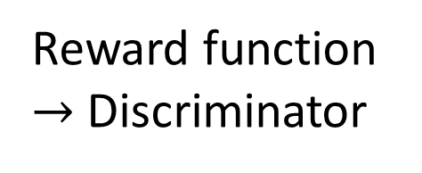
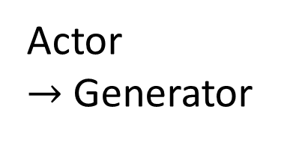
Framework of IRL
The expert is always the best.
$$\sum_{n=1}^{N}{R\left({\hat{τ}}_{n}\right)}>\sum_{n=1}^{N}{R\left(τ\right)}$$
Expert $\hat{π}$
Obtain
Reward Function R
$$\left\{{\hat{τ}}_{1},{\hat{τ}}_{2},⋯,{\hat{τ}}_{N}\right\}$$
Reward Function R
$$\left\{τ_{1},τ_{2},⋯,τ_{N}\right\}$$
Actor
$→$ Generator
Find an actor based on reward function R
Reward function $→$ Discriminator
Actor $π$
By Reinforcement learning
Notes:
修改遊戲規則 到

Slide 13




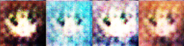
GAN
High score for real,
low score for generated
D
G
Find a G whose output obtains large score from D
IRL
Larger reward for ${\hat{τ}}_{n}$,
Lower reward for $τ$
Expert
$$\left\{{\hat{τ}}_{1},{\hat{τ}}_{2},⋯,{\hat{τ}}_{N}\right\}$$
$$\left\{τ_{1},τ_{2},⋯,τ_{N}\right\}$$
Reward Function
Find a Actor obtains large reward
Actor

Slide 14
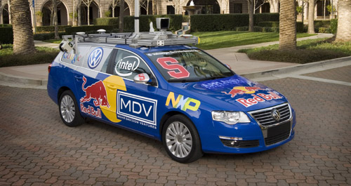
Parking Lot Navigation
Reward function:
Forward vs. reverse driving
Amount of switching between forward and reverse
Lane keeping
On-road vs. off-road
Curvature of paths

Slide 16
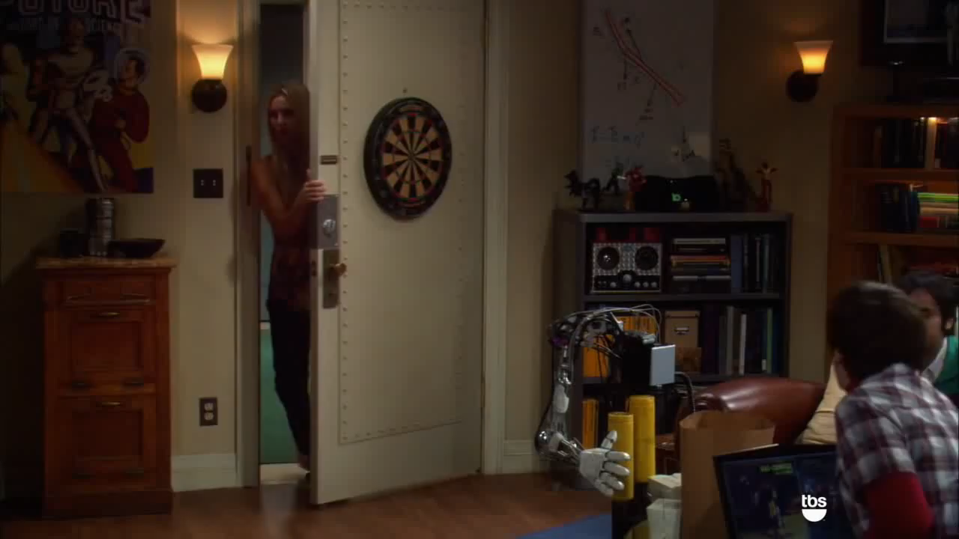
Robot
How to teach robots?
https://www.youtube.com/watch?v=DEGbtjTOIB0

Slide 17
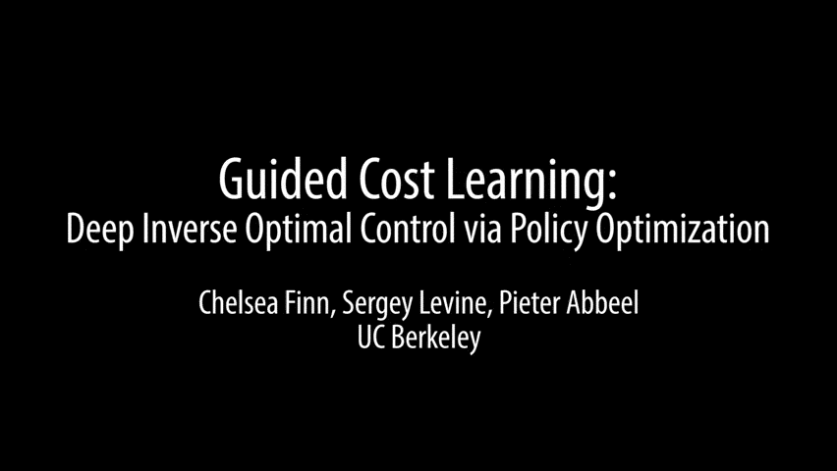
Robot
Chelsea Finn, Sergey Levine, Pieter Abbeel, ” Guided Cost Learning: Deep Inverse Optimal Control via Policy Optimization”, ICML, 2016
http://rll.berkeley.edu/gcl/
Notes:
The reward function is not linear.

Slide 18
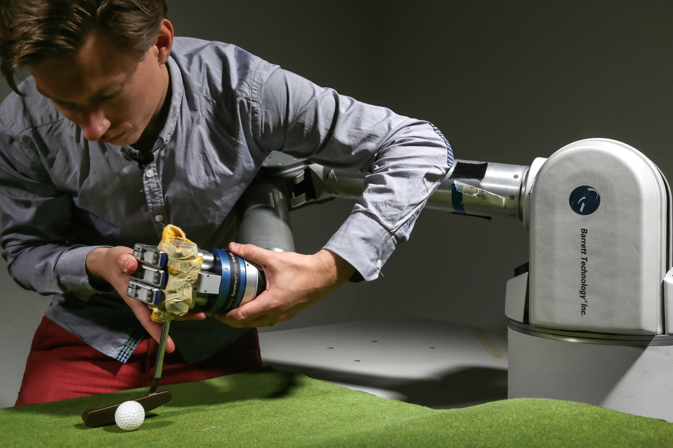
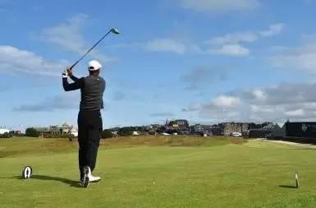
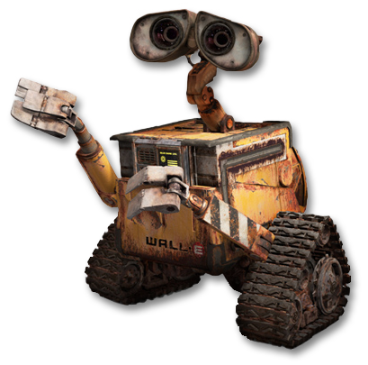
Third Person Imitation Learning
Ref: Bradly C. Stadie, Pieter Abbeel, Ilya Sutskever, “Third-Person Imitation Learning”, arXiv preprint, 2017
First Person
Third Person
http://lasa.epfl.ch/research_new/ML/index.php
https://kknews.cc/sports/q5kbb8.html
http://sc.chinaz.com/Files/pic/icons/1913/%E6%9C%BA%E5%99%A8%E4%BA%BA%E5%9B%BE%E6%A0%87%E4%B8%8B%E8%BD%BD34.png

Slide 19
Third Person Imitation Learning

Slide 20
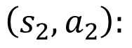
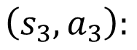
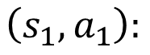
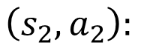
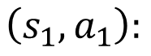
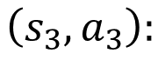
Recap: Sentence Generation & Chat-bot
Chat-bot
Sentence Generation
Expert trajectory:
input: how are you
Output: I am fine
Expert trajectory:
床 前 明 月 光
(“<BOS>”,”床”)
(“input, <BOS>”,”I”)
$$\left(s_{1},a_{1}\right):$$
$$\left(s_{1},a_{1}\right):$$
(“床”,”前”)
(“input, I”, ”am”)
$$\left(s_{2},a_{2}\right):$$
$$\left(s_{2},a_{2}\right):$$
(“床前”,”明”)
(“input, I am”, ”fine”)
$$\left(s_{3},a_{3}\right):$$
$$\left(s_{3},a_{3}\right):$$
……
……
……
……
Maximum likelihood is behavior cloning. Now we have better approach like SeqGAN.

